Slide 1


Slide 2
Good Morning!
Selamat Pagi!
Magandang Umaga!
☺

Slide 3

Listen
Participate
Respect
Learn and have fun!

Slide 4
Learning Objectives
Through the discovery learning model, the students are able to understand the three theories about the origin of the Indonesian Ancestors (Yunnan Theory, Theory out of Africa, and Nusantra Theory) and their supporting evidences.

Slide 5
Jumbled Letters
Directions:
The objective of the game is to rearrange or unscramble the letters to form a word in the carton.

Slide 6
Matching Type
Directions:
Match column A to column B.
Define the words.

Slide 7
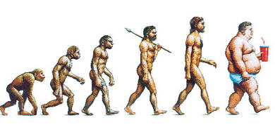
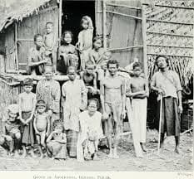
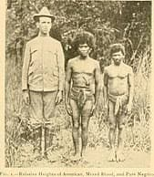
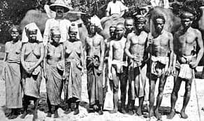
Form a Question…

Slide 8
Theories About the Origin of Indonesian People

Slide 9
Think & Share
DIRECTIONS:
You will be divided into groups with 5-6 members in each group.
Each group will answer the following questions and later on present it in front of the class.
You are given 15 minutes to prepare and answer the questions.

Slide 10
Group Guide questions:
Explain Yunnan Theory and cite its evidences.
Explain Out of Africa Theory and cite its evidences.
Explain Nusantara Theory and cite its evidences.

Slide 11
Individual Guide Questions:
Among the three theories, what theory does convince you? Cite evidences.
What theory do you think is not the origin of the Indonesian ancestors? Why?
3. If you were to create a new theory about the origin of the Indonesian people, what would it be?
a. Where are the traces of the origins?
b. What are the evidences?

Slide 12
Thank You!

Slide 13
Theories About the Origin of Indonesian People

Slide 14


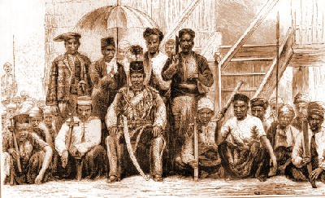
1. Yunnan Theory
A. negritos
B. malay proto
C. Deutro malay

Slide 15
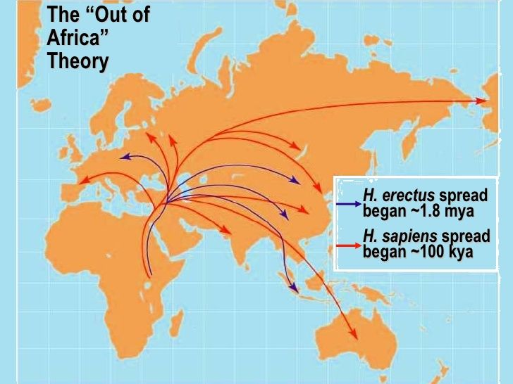
2. Theory of Out of Africa

Slide 16
3. Nusantara Theory

