Slide 1
Good Morning!
☺

Slide 2

Let’s study!
Listen
Participate
Respect
Learn and have fun!

Slide 3
Review
YUNNAN | OUT OF AFRICA | NUSANTARA

Slide 4
Race Migration Process Proto Melayu, Malay Deutro, and Melanosoid to Indonesia
Prepared By:
Bernardo, Precious

Slide 5
Learning Objectives
The students are able to understand the race migration process, characteristics, distribution, and culture of Melanosoid, Proto Malay, and Malay Deutro to Indonesia.

Slide 6
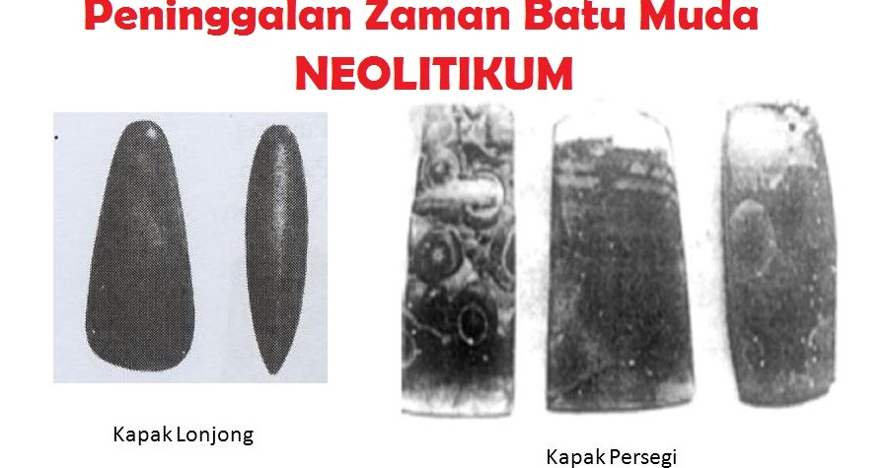
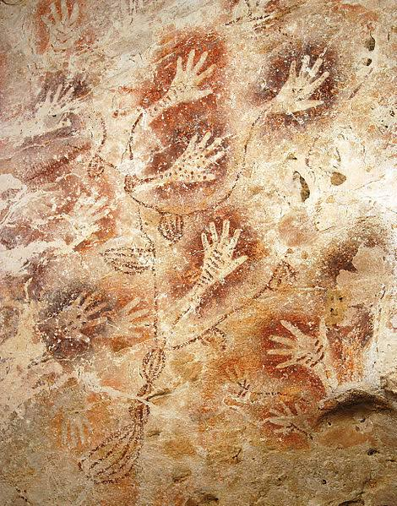
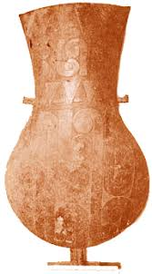
Form a Question…
A
B
C
D

Slide 7
Camaraderie

Slide 8
Group Activity
DIRECTIONS:
You will be divided into groups with 5-6 members in each group.
Each group will answer the following questions and later on present it in front of the class.
You are given 20 minutes to prepare and answer the questions.

Slide 9
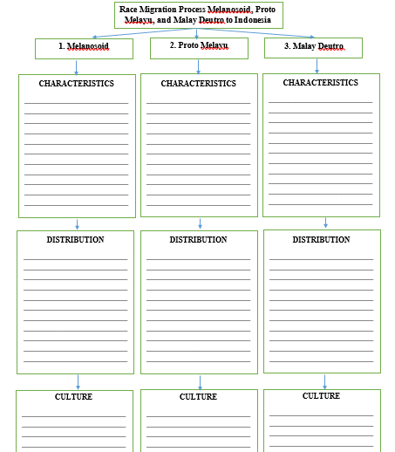
Graphic Organizer

Slide 10
Conclusion…
I learned about…

Slide 11
HONESTY
is the best policy

Slide 12
Directions:
MULTIPLE CHOICE
Read each statement carefully.
Write the letter of your choice on a sheet of paper.

Slide 13
Number 1
It is thought to be the ancestor of Melanosoid humans who became residents of islands of Papua and Australia before rising sea levels at the end of ice age.
A. Tabon Man C. Wajak Man
B. Callao Man D. Dongson Man

Slide 14
Number 2
According to the reading, this culture is more advanced than the Melanosoid nation in terms of making tools for planting, pottery, and jewelry.
Proto Malay C. Deutro Malay
B. Melanesian D. None of the above

Slide 15
Number 3
This nation is the first wave to migrate in Indonesia.
A. Melanesian C. Deutro Malay
B. Proto Malay D. None of the above

Slide 16
Number 4
This race was able to give birth to new culture which later became the culture of the Indonesian people now.
A. Melanesian C. Deutro Malay
B. Proto Malay D. None of the above

Slide 17
Number 5
They carry the Neolithic culture, which is oval ax which is carried through the east lane and square ax through the west lane.
A. Melanesians C. Deutro Malays
B. Proto Malays D. None of the above

Slide 18
Key Answer

Slide 19
Multiple Choice Answers
C
A
A
C
C

Slide 20
Thank You!
☺

