Slide 1
September 24, 2019
X IPA 1

Slide 2

Hello!
I am Precious Bernardo
Selamat Pagi!

Slide 3
Review
Race Migration Process Proto Melayu, Malay Deutro, and Melanosoid to Indonesia

Slide 4
Pass the Message
Lyrics:
Fly, fly, fly
The butterfly
In the meadow, is flying high
In the garden, is flying low
Fly, fly, fly
The butterfly

Slide 5
“Without history,
there would be no future.”

Slide 6

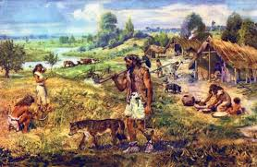
The Style of Life of the
Pre-Historic People in Indonesia

Slide 7
Learning Objectives
Through Discovery Learning Model, the students are able to understand the results and cultural values of Indonesian Prehistoric communities and their influence in the lives of the nearest environment and present the results and cultural values of the Indonesian Prehistoric community and their influence on the life of the nearest environment in written form

Slide 8
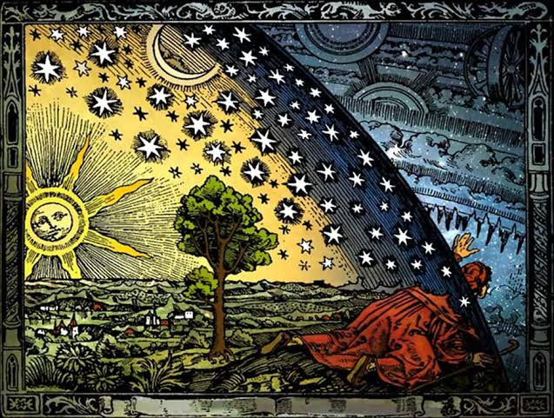

Slide 9

Questions I wanna ask…

Slide 10
Group Activity
DIRECTIONS:
You will be divided into groups with 5-6 members in each group (random counting).
Each group will answer the following questions and later on present it in front of the class.
You are given 20 minutes to prepare and complete the graphic organizer.

Slide 11
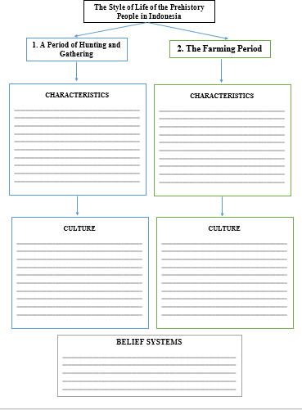
Graphic Organizer

Slide 12
Conclusion…
I learned about…

Slide 13
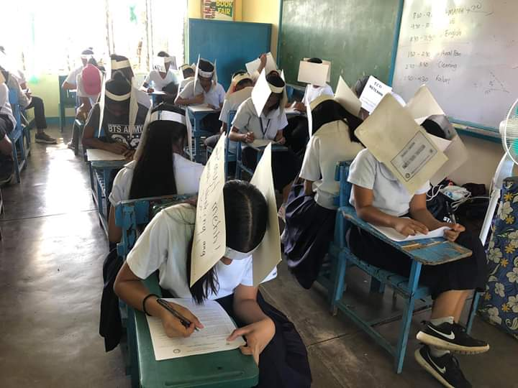

Slide 14
O= Hunting and Gathering Period
X= Farming Period
_____1. Life is always nomadic.
_____2. Live in large groups in a village.
_____3. There are tribal leaders who are chosen.
_____4. Live in small groups between 10 to 15 people.
_____5. Barter exchange.

Slide 15
SHORT ESSAY
What is the relevance of studying the history of Indonesia to your present and future?
____________________________________________________________________________________________________________________________________________________________________________________________________________________________________________________________________________________________________________________________________________________________________________________________________________________________________

Slide 16

Key Answer
1. O
2. X
3. X
4. O
5. X

Slide 17
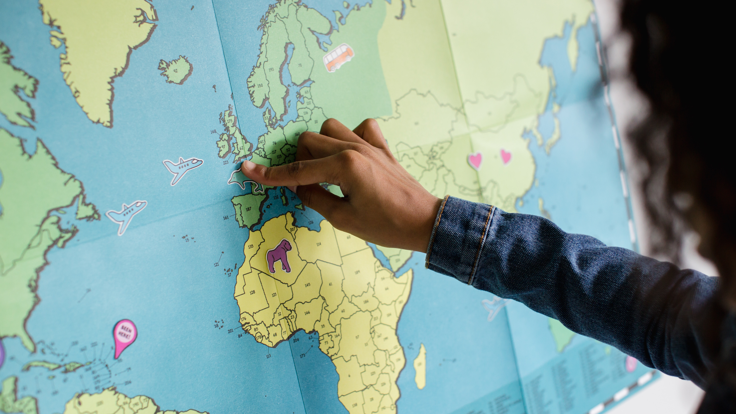
Thank You,
Science 1 ☺

